Slide 1

Amazon
2021Group4

Slide 2
Outline
Information
Revenue Stream
Bussiness Model
Product & Service
Target Client
Revenue
Profit
Revenue v.s. Profit

Slide 3
Information
Founder : Jeff Bezos
Founded date : 1994/7/5
Founded place : Bezos’ garage in Bellevue, Washington
Began as an online bookstore and expanded to other fields later
Launched Amazon Web Services(AWS) in 2002.
Surpassed Walmart in 2015.
Acquired Whole Foods Market in 2017.
Amazon Prime(delivery service) surpassed 100 million subscribers in 2018.
Has the highest global brand valuation in 2020.
Acquisitions: Ring, Twitch, Whole Foods Market and IMDb
Notes:
Bellevue, Washington : 西北，西雅圖附近
Walmart : 世界上最大的零售商
Ring : home security and smart home company
Whole Foods Market : 美國的食品超級市場連鎖店
IMDb(Internet Movie Database) : 一個關於電影演員、電影、電視節目、電視藝人、電子遊戲和電影製作小組的線上資料庫(網站)

Slide 4
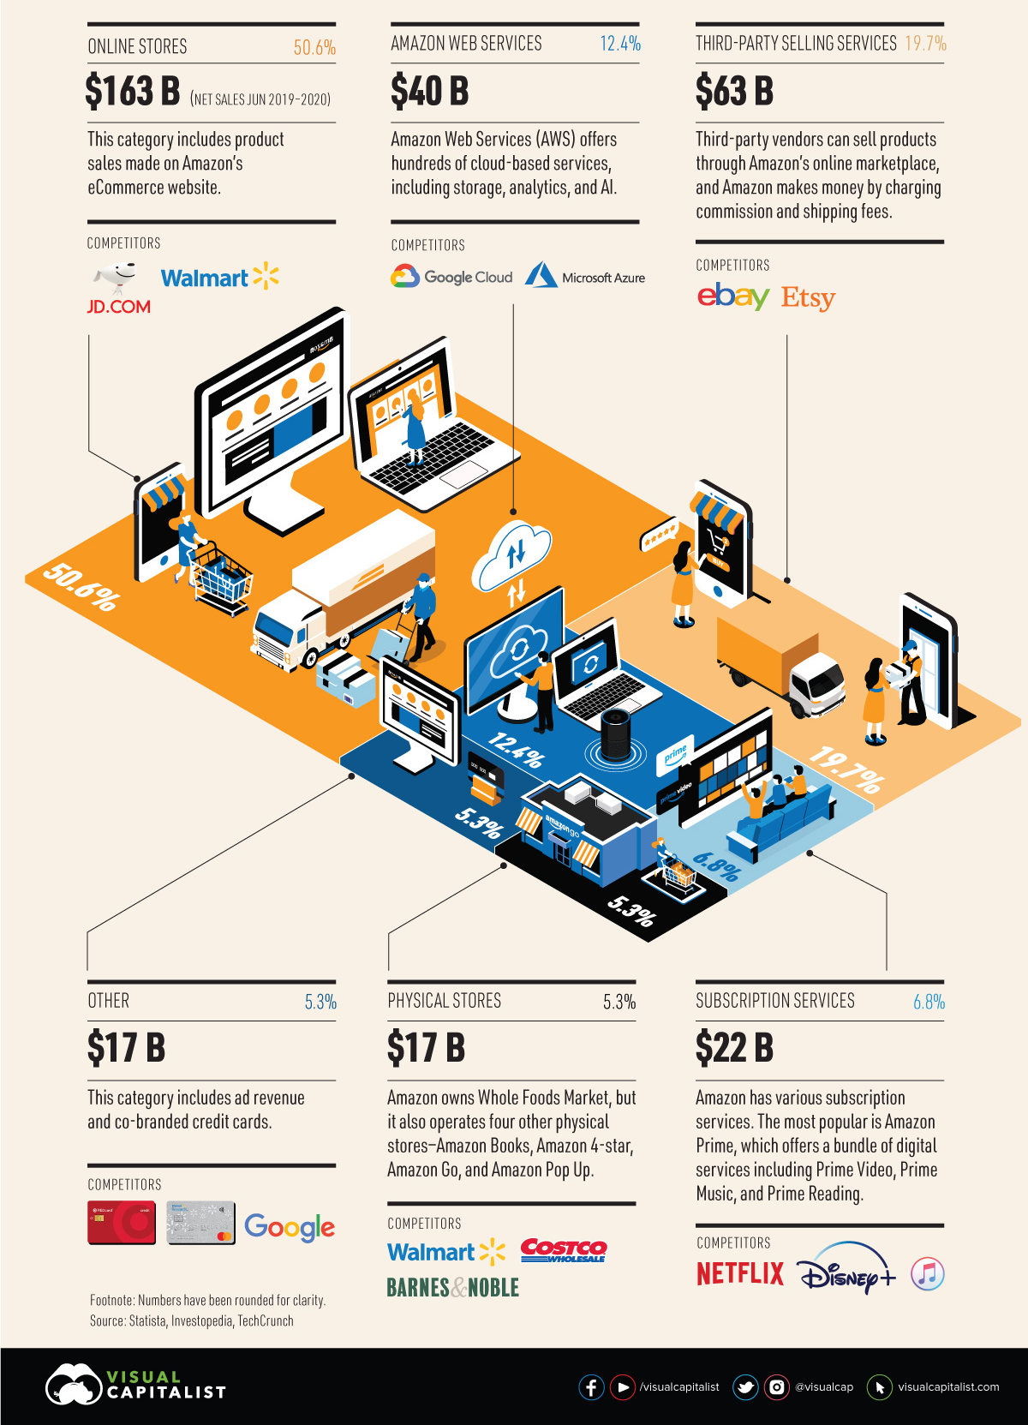
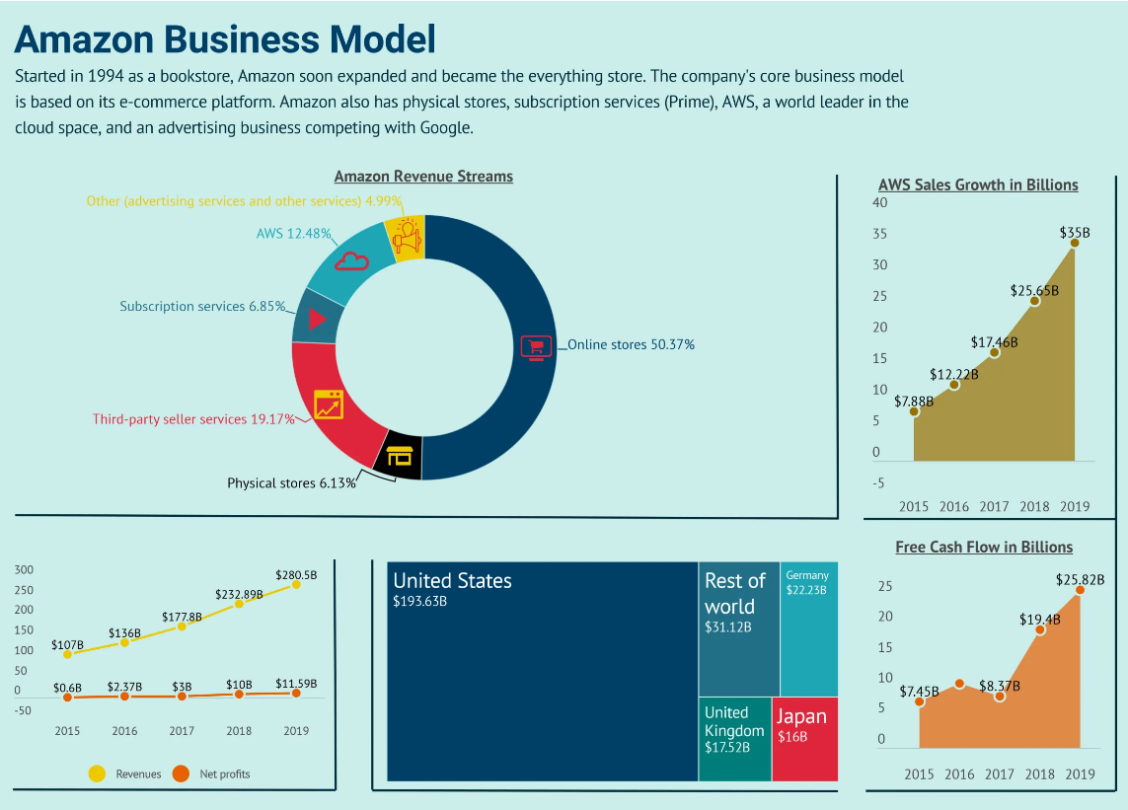
Revenue stream
https://fourweekmba.com/amazon-business-model/

Slide 5
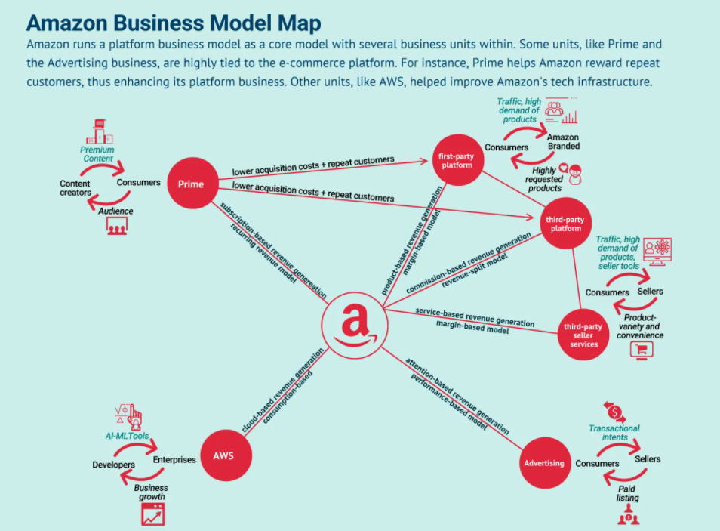
Bussiness Model
higly diversified
https://fourweekmba.com/amazon-business-model/
Notes:
cycle:彼此間的關係
pic data : 2019
Prime(subscription services) : both an accelerant to Amazon’s forward motion and a beneficiary
Bezos repeatedly called Prime the company’s “flywheel”: a device used in engines that provides constant energy. It is both an accelerant to Amazon’s forward motion and a beneficiary.

Slide 6
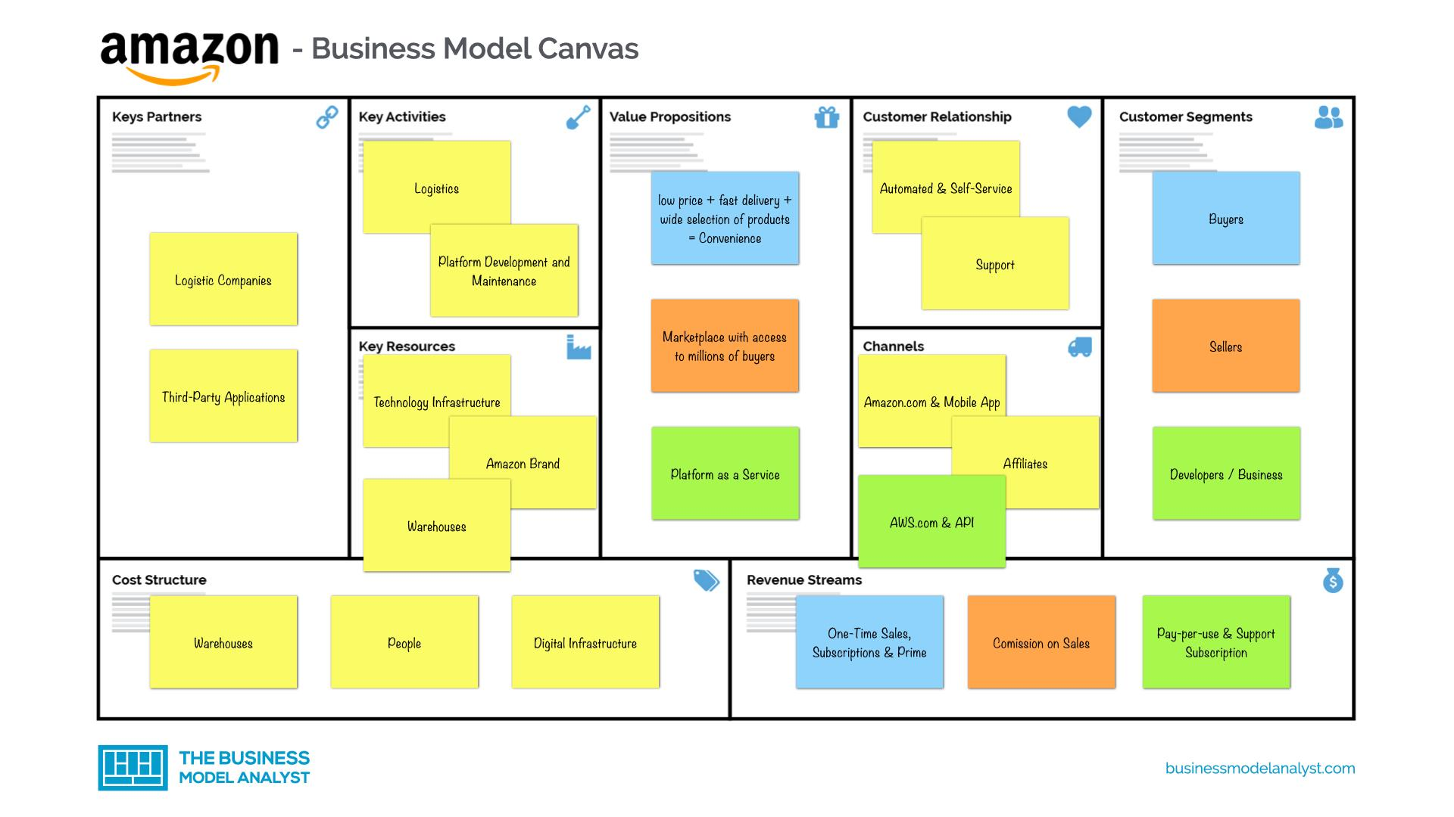
Bussiness Model
Support
Notes:
供給(如何提供)、價值、需求(為誰提供)、財務導向
Logistics:後勤處理，包括從顧客下單到拿到商品的所有過程(撿貨、物流...)，Amazon deal with it with it’s fulfillment center
self-service : In this type of relationship, a company maintains no direct relationship with customers. It provides all the necessary means for customers to help themselves.
automated service : Automated services can recognize individual customers and their characteristics, and offer information related to orders or transactions. At their best, automated services can stimulate a personal relationship
Support(relationship) : an alternative term for “technical support”, is a specific type of customer service that deals with servicing a product.Customer support is for companies that offer complex technological products
affiliate(channels) : Any Amazon user can sign up to work as an affiliate. Amazon provides a unique link to a product for each affiliate(e.g. A book review contains a link to the book on Amazon. Any book sales through the link generate a commission for the book reviewer.)
pic date : 2020

Slide 7
Product & Service
E-commerce
Many categories
AmazonFresh(2007)
Amazon GO(2016)
selling tools(inventory management, payments processing, shipments tracking, etc.)
Cloud computing
AWS(2002)
Consumer electronics
Kindle ereaders(2007)
Fire tablets
Alexa
Digital streaming
Prime Video
Amazon Music
Twitch(2014)
Audible
Publishing
Amazon Publishing(2007, programs that allow content creators to publish and sell their content directly via Amazon platform)
Film and TV studio
Amazon Studios
Self-driving cars
Zoox(2020)
Notes:
Amazon GO : 吾人商店
Zoox : focus on Robo-taxi. Acquired by Amazon.

Slide 8
Target Client & Product
Consumers
E-commerce
Digital streaming
Consumer electronics
Sellers
E-commerce
Developers and enterprises
AWS
Content creator
Amazon Publishing
Amazon Studios

Slide 9
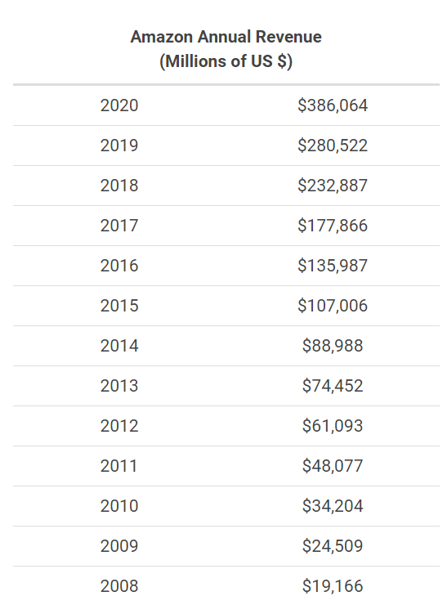
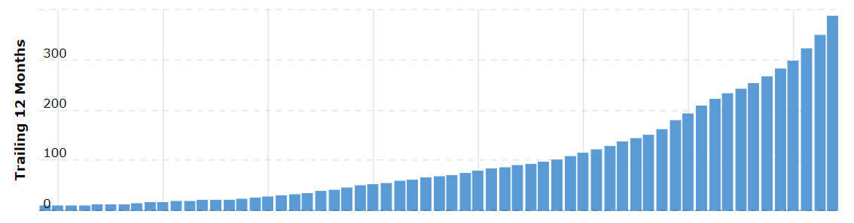
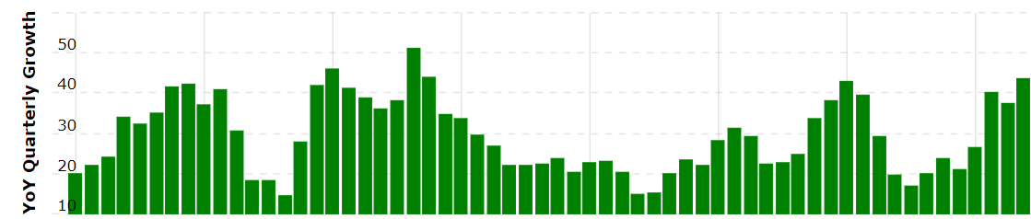
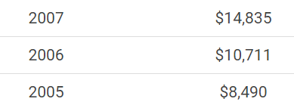
Revenue
(Millions of US $)
https://www.macrotrends.net/stocks/charts/AMZN/amazon/revenue
Notes:
2005=>2020成長45倍

Slide 10
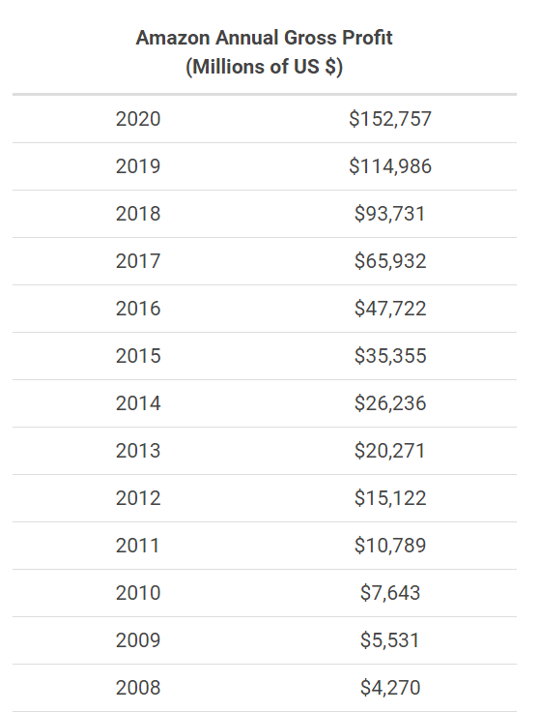
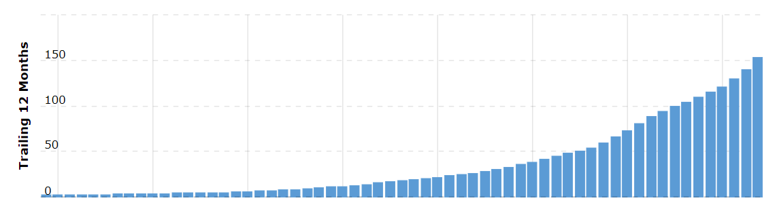
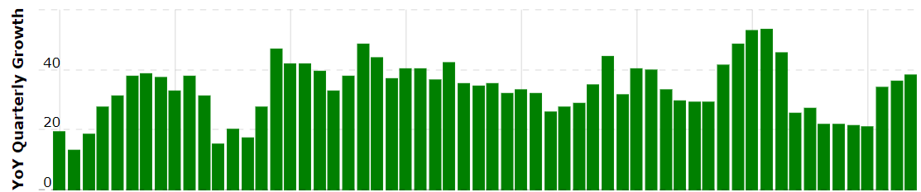
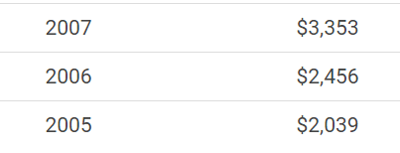
Profit
(Millions of US $)
https://www.macrotrends.net/stocks/charts/AMZN/amazon/revenue
Notes:
2005=>2020成長75倍

Slide 11
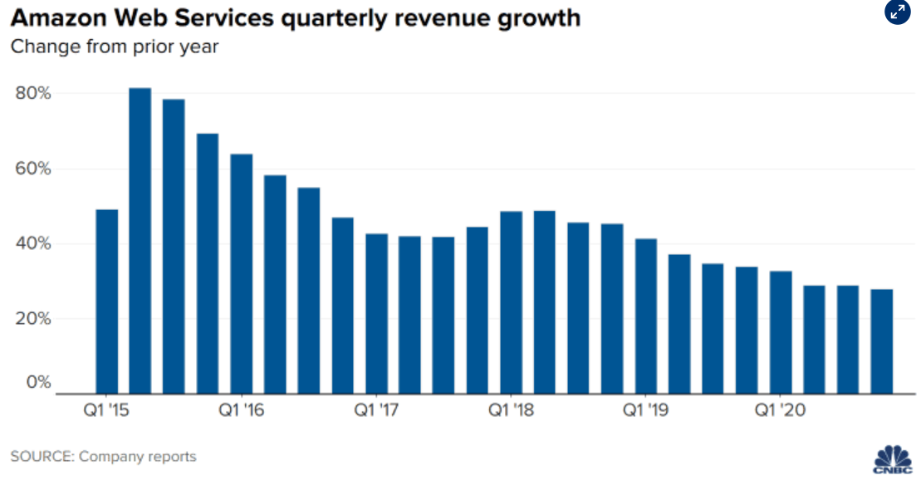
AWS Web Services Revenue Growth

Slide 12
Revenue v.s. Profit
 | Revenue | Profit
2017=>2018 | +30.93% | +42.16%
2018=>2019 | +20.45% | +22.68%
2019=>2020 | +37.62% | +32.85%
 | Profit/Revenue
2017 | 37.07%
2018 | 40.25%
2019 | 40.99%
2020 | 39.57%
Notes:
成本up

Slide 13
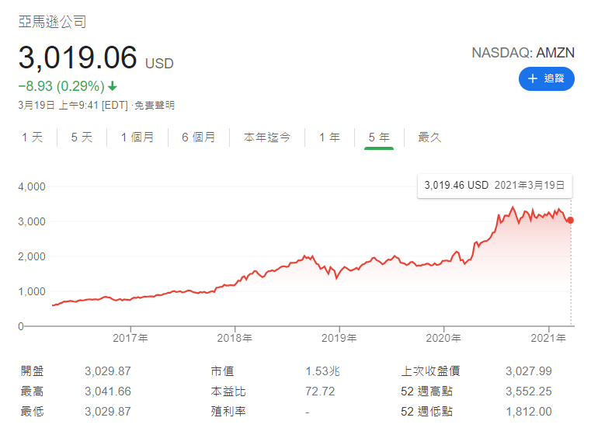
Stock Growth
Notes:
2020/3~2020/8從谷底到頂峰

